Slide 1
What’s the use?
Reconstructing cultural property after war
Dr. Elizabeth Scarbrough
Florida International University

Slide 2
Outline of talk
I/ Introduction
II/ Examples:
  Mỹ Sơn Archaeological Sanctuary (A1 kalan)
  9/11 Memorial
  III/ Monuments, Memorials and Ruins
  IV/General Conclusions
Notes:
In this paper, I ask whether and how we should reconstruct cultural material destroyed (or partially destroyed) by war. I will focus my attention on immovable cultural property, e.g., architectural ruins, monuments, and public sculptures. In trying to answer the question of whether to reconstruct immovable cultural property, I will focus on its use-value: What will the site (and structures on the site) be used for? I will argue that ruins have a use-value distinct from memorials and monuments. While their use-value is primarily aesthetic, it is nonetheless important. I will discuss two particular cases where communities had to decide whether to reconstruct, repurpose, or allow immovable cultural heritage to rest in peace, i.e., ruinate. The first case is the A1 kalan at the Mỹ Sơn archaeological sanctuary damaged during the American/Việt Nam war. The second case is the destruction of the Twin Towers on 9/11. In both cases, decisions had to be made as to what to do with the rubble and surrounding landscape after acts of war. For Mỹ Sơn, communities decided to preserve the ruins of the tower at A1, while the Twin Towers were turned into a memorial. Despite the different outcome, the use-value of ruins, memorials, and monuments were appropriately weighed in both cases.

Slide 3
Outline of talk
I/ Introduction
II/ Examples:
  Mỹ Sơn Archaeological Sanctuary (A1 kalan)
  9/11 Memorial
  III/ Monuments, Memorials and Ruins
  IV/General Conclusions

Slide 4
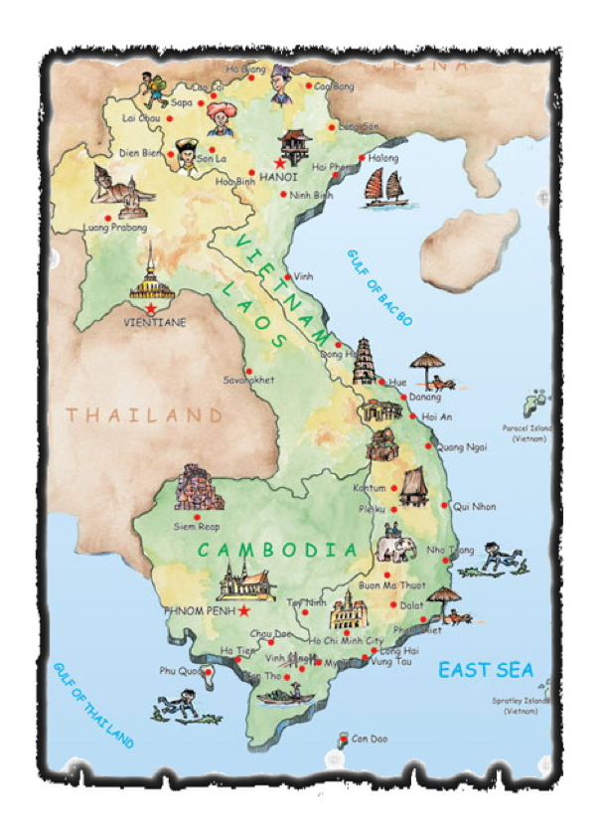
Notes:
Mỹ Sơn Archaeological Sanctuary is the foremost Champa archaeological site and largest archaeological site in Việt Nam. A religious sanctuary protected in a deep valley surrounded by high mountain ranges, the Champa ruins consist primarily of brick temple towers called kalans, built successively from the late 4th/5th centuries until the 13th/14th centuries.

Slide 5
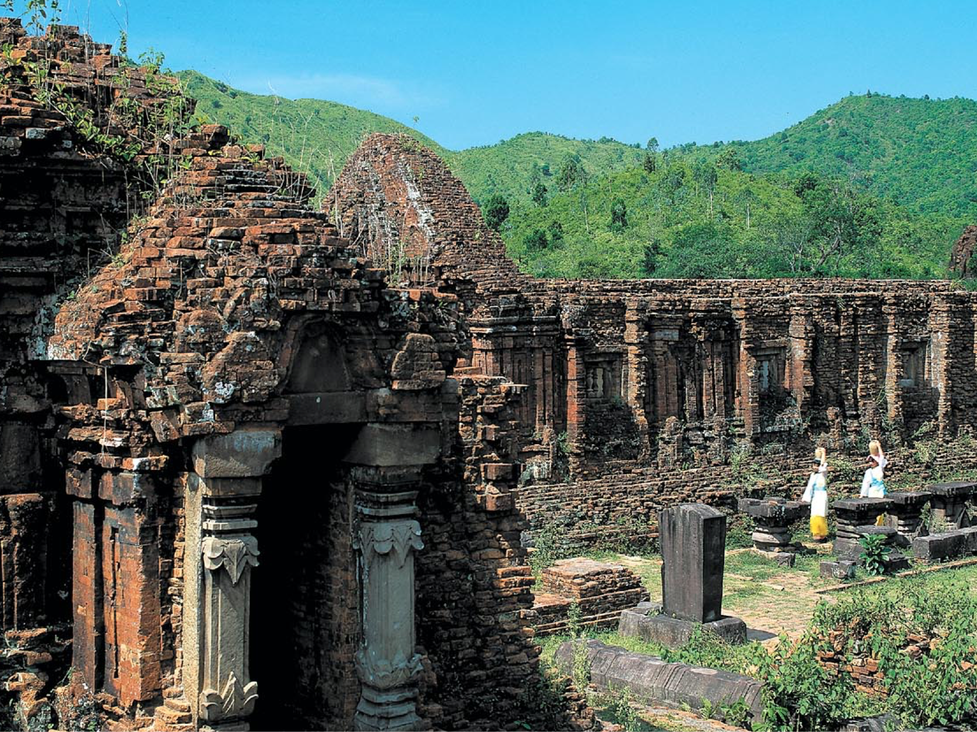
Notes:
A kalan is a corbel structure composed of bricks that are stacked in a slightly offset manner. Similar to Khmer and Central Javanese architecture, the Cham produced kalans with a three-level pyramid-shaped roof. What makes Mỹ Sơn unique is not just its size, but its iconography. Unlike similar temple structures in South East Asia (such as Angkor Wat), Mỹ Sơn’s iconography remained Hindu. When the Cham kings converted to Buddhism around the 11th century, the temples were by in large not altered but supplemented – leaving the Hindu iconography intact. The Khmer invaded this territory in the 13th century and by the 15th century, the Vietnamese annexed the last bit of Cham territory in the Cham-Vietnamese war. The Cham were forcibly moved from their homes, with most relocating into Cambodia and coastal Malaysia. Some Cham remained in Việt Nam, where they converted to Islam. Today, the Cham are recognized as one of fifty-four ethnic minority groups in Việt Nam. They represent the majority of Islamic peoples in both Cambodia and Việt Nam. During French colonization, a group of French soldiers “rediscovered” Mỹ Sơn in 1885. Between 1896 and 1902 a group of French archaeologists (led by Henri Parmentier) cataloged the site, giving the architectural groupings the number and letter designations we still use.

Slide 6
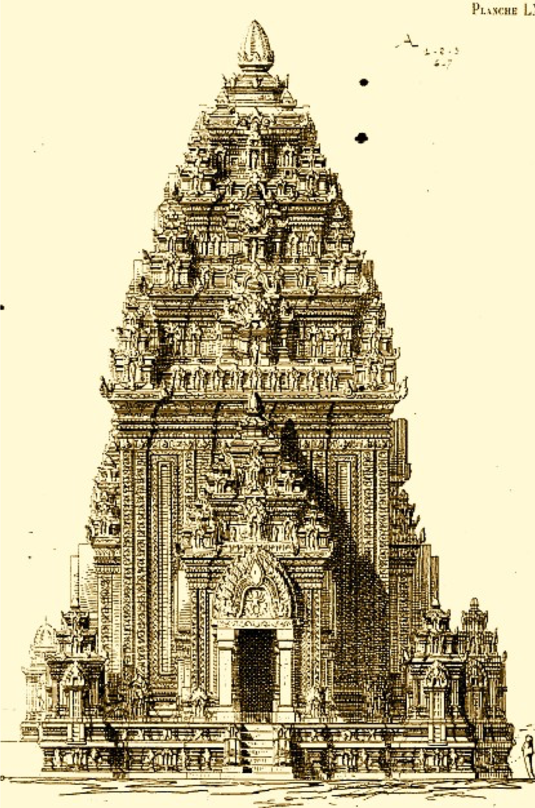
Notes:
Here you can see a drawing by Parmentier of A1, the largest and most majestic kalan in the archaeological complex.
In August of 1969, a bomb dropped by an American B52 bomber struck Mỹ Sơn, reducing this largest temple to rubble.

Slide 7
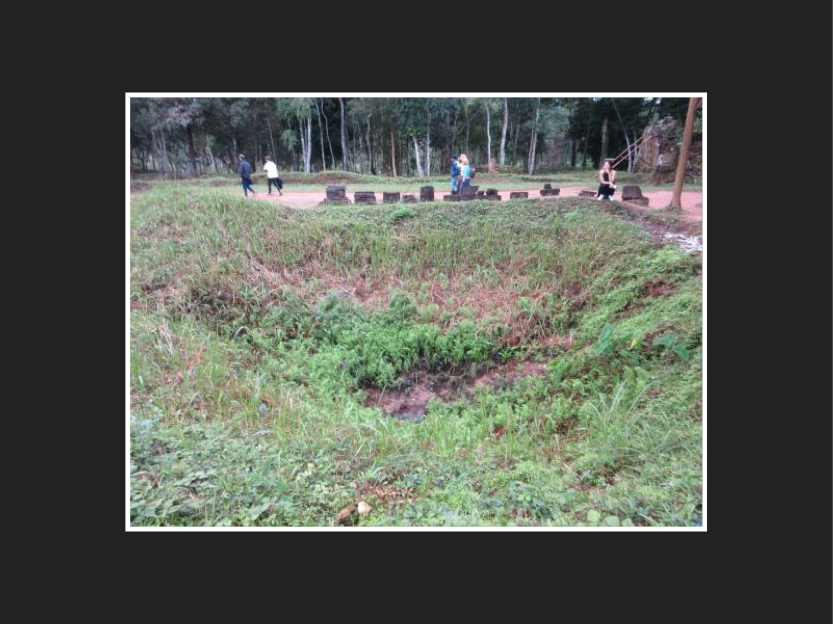
Notes:
In 1970, under intense international pressure, President Nixon agreed to spare Mỹ Sơn from any further attacks. After the American/Việt Nam War, the Vietnamese government de-mined Mỹ Sơn so that restoration work could begin. In 1980, a Polish team of scientists consolidated the rubble, preserved stray bricks from the elements, and began to reconstruct some of Mỹ Sơn’s temples. In 1999 UNESCO deemed Mỹ Sơn a World Heritage Site.
Mỹ Sơn is an interesting case study because of its long history, and the diversity of structures on the site. There are structures that have been allowed to ruinate with little human intervention; there are structures that have been restored, and there are structures that have been completely reconstructed.
A1 has been left to ruinate. We cannot be sure what existed before the bombing (the records are unreliable, and we know the site had been heavily pillaged). However, we know that what existed after the bombing was a pile of rubble, a crater, and the ceremonial pedestal.

Slide 8
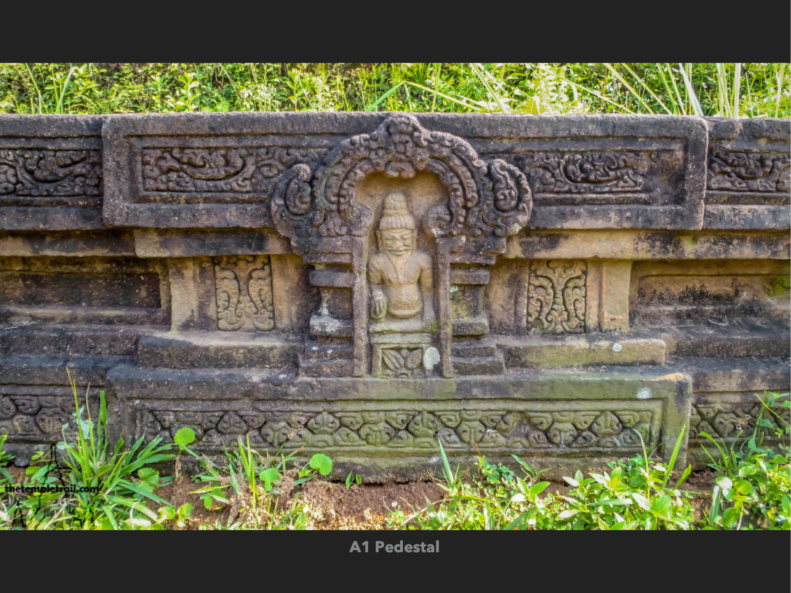
Notes:
There are no placards contextualizing the site currently – no reading material discussing the bombing, although the bomb craters are obvious. The only contextualizing you will find is by local tour guides.

Slide 9
Outline of talk
I/ Introduction
II/ Examples:
  Mỹ Sơn Archaeological Sanctuary (A1 Kalan)
  9/11 Memorial
  III/ Monuments, Memorials and Ruins
  IV/General Conclusions
Notes:
“The National September 11 Memorial & Museum” in New York City memorializes the September 11th attacks, which killed 2,977 people. Six months after the attack a temporary memorial was erected.

Slide 10
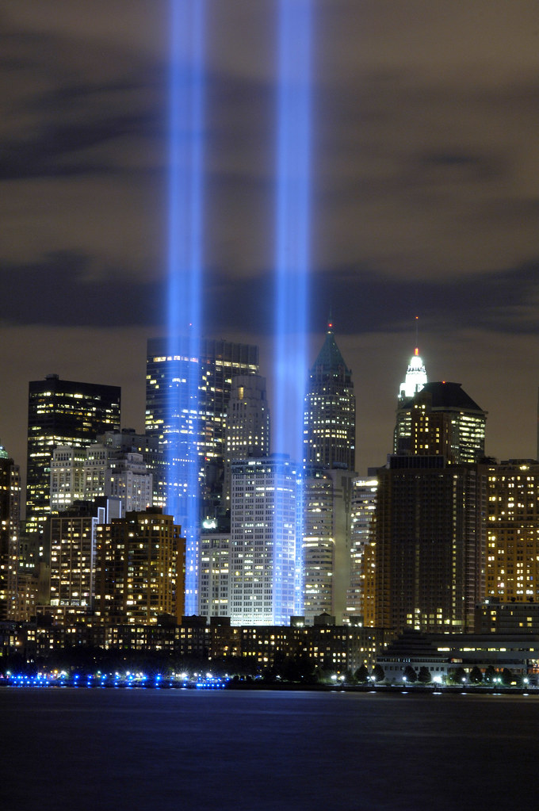
Notes:
(Built by artist Julian LaVerdiere and Paul Myoda,) this “tower of light” had originally been planned to be atop one of the Twin Towers for an anniversary celebration (called then the Bioluminescent Beacon). What followed was an open call for proposals to determine the appropriate memorial site Erected in March 11, 2002 these “towers of light” were eight-eight seven thousand wat high intensity lights illuminated where the original towers stood.

Slide 11
Memorial Elements
(1) to recognize each individual who was a victim of the attack
(2) to provide a space for contemplation
(3) to create a unique and powerful setting and
(4) to covey historic authenticity.
Notes:
The design committee listed four main program elements; (1) to recognize each individual who was a victim of the attack, (2) to provide a space for contemplation (3) to create a unique and powerful setting and (4) to covey historic authenticity. Anyone was allowed to submit a single 30 by 40-inch rigid board, which would be judged by 13 jurors. Among the jurors was a family member of a victim of the 9/11 attack, and Maya Lin, the designer of the Việt Nam Memorial. By mid-October eight finalist were chosen, but received an “underwhelming” reception. The public, who had access to the designs, decried them as “too cold” “too fashionable” and “too generic.”

Slide 12
Quotes about 9/11 memorial
ARCHITECTURE; Ground Zero’s Only Hope: Elitism
  “Democratic competitions are only as good as the people who choose to take part in them.…But good art, like science, is not democratic. An open competition can produce a Maya Lin Vietnam memorial once in a generation, maybe, but mostly it results in the generic monuments that are now the universal standard”
  -Michael Kimmelman
Notes:
Michael Kimmelman, a New York Times columnist wrote in his piece “ARCHITECTURE; Ground Zero’s Only Hope: Elitism,” “Democratic competitions are only as good as the people who choose to take part in them.…But good art, like science, is not democratic. An open competition can produce a Maya Lin Vietnam memorial once in a generation, maybe, but mostly it results in the generic monuments that are now the universal standard.” However, once the memorial was built, the reception has been positive.

Slide 13
Quotes about 9/11 memorial
“the most powerful example of commemorative design since Maya Lin’s Vietnam War Memorial . . . a sobering, disturbing, heartbreaking, and overwhelming masterpiece.”
  -Martin Filler
Notes:
Martin Filler, the architecture critic for the New York Review of Books called it “the most powerful example of commemorative design since Maya Lin’s Vietnam War Memorial . . . a sobering, disturbing, heartbreaking, and overwhelming masterpiece.”

Slide 14
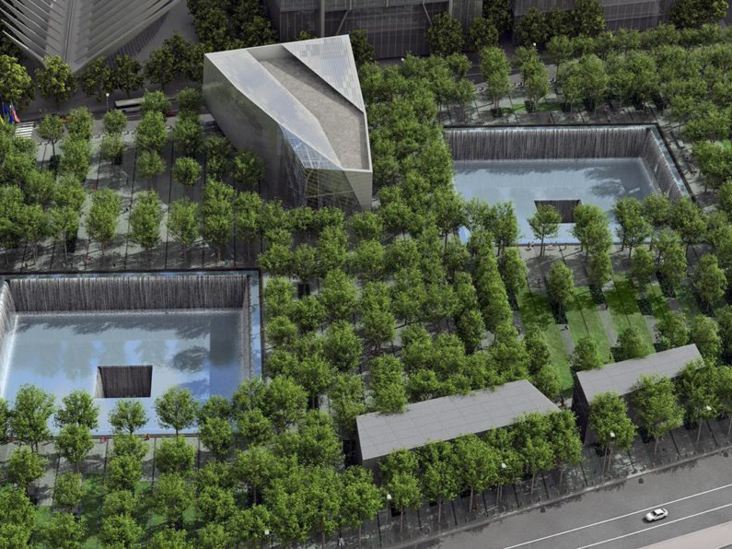
Notes:
The winning design consists of an outdoor area composed of twin reflecting pools, which mirror the shape and size of the original footprints of the buildings, and an indoor museum. The museum presents two types of exhibits: historical and memorial. Inside the museum structure there are several items relevant to our discussion. In “Foundation Hall” we see the “Remnants of the original World Trade Center, including the slurry wall and the celebrated Last Column.”

Slide 15
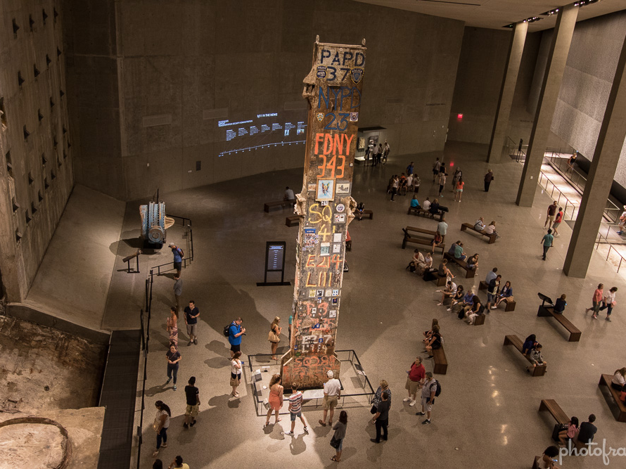
Notes:
The slurry wall, still remaining, is a 3-foot-thick concrete barrier which stood after the towers fell. It keeps the Hudson River from spilling into the space. Wired magazine called the exhibit space showing the slurry wall an “unprecedented hybrid of archaeological site, cathedral, and tourist attraction.” “The Last Column” was the final piece of steel removed from the Ground Zero site.

Slide 16
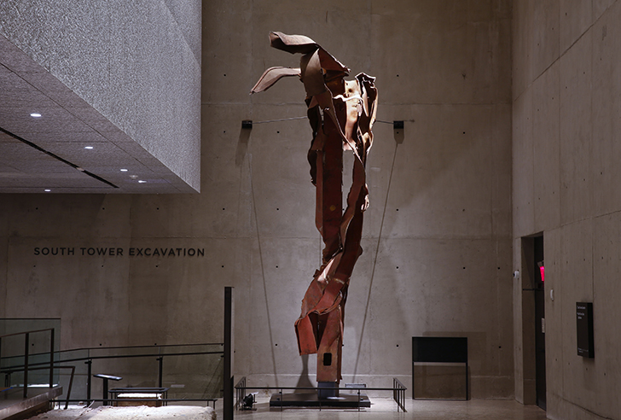
Notes:
“Impact Steel” are a set of exterior columns which show where flight 11 collided with the North Tower. This section of steel has also been referred to as the “Angel of 9/11” as the particular twist of the steel tricks the mind into seeing a “face.”

Slide 17
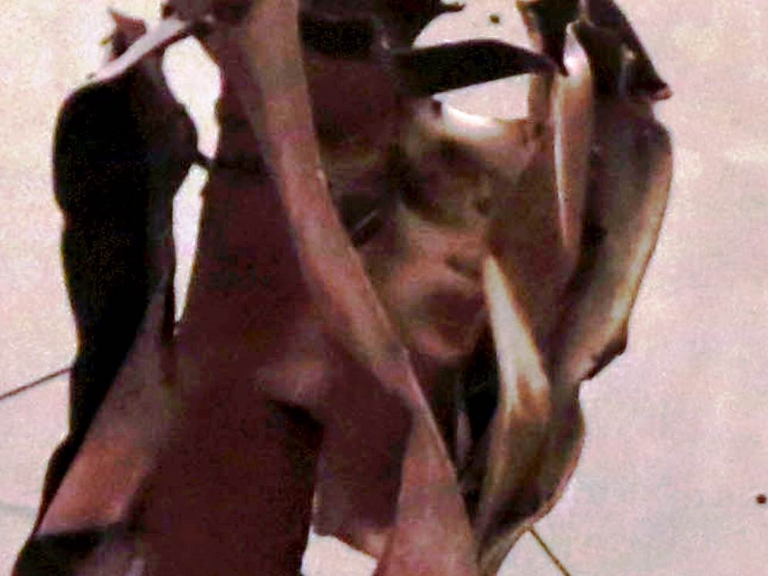
Notes:
Angel face

Slide 18
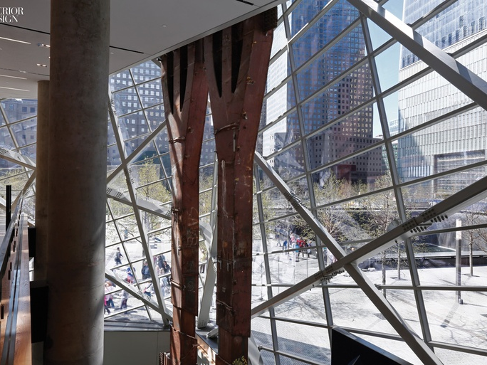
Notes:
The Twin Tower “Tridents” have been placed in the entry pavilion. These two 80-foot-tall steel columns were once part of the North Tower. World Trade Center architect, Minoru Yamasaki, calls these tridents the “trees.”

Slide 19
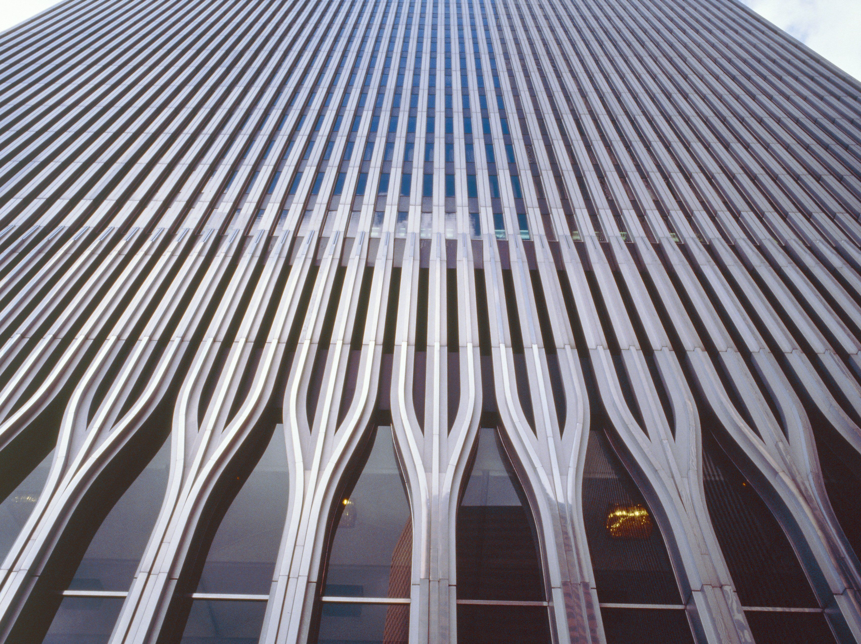
Notes:
These trees formed the first five stories of each tower and are now some of the first objects you see inside the museum. They stand tall as you take an escalator down several floors. Tom Hennes of Thinc architects states, “Procession is an integral part of memorials, and here the whole story is told on the ramp going down, through still images, narratives, and objects, contrasting the many with the one.” The objects I’ve described are all seen on this journey down into the underbelly of the museum, where you witness the slurry wall and the last column. Outside the museum memorial walls, you can walk around the grounds of the memorial.

Slide 20
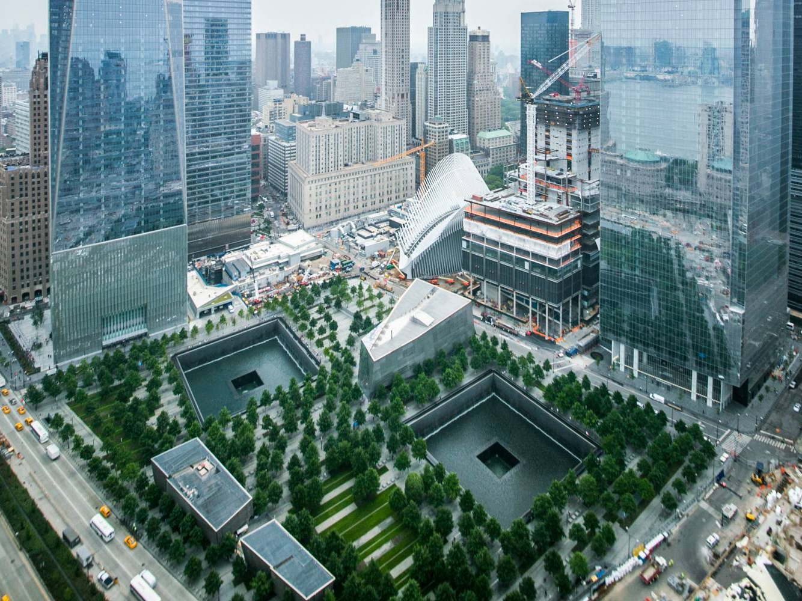
Notes:
The design of the outside memorial, made by architect Michael Arad and landscape architect Peter Walker, incorporates the original footprints of the two felled towers, encased in bronze which are inscribed with the names of the fallen. These recessed pools have been referred to as “memorial voids” by the architects. The names of the victims illuminate at nighttime. The bronze is offset by rows of deciduous trees. The architects wanted the footprints to “reflect absence” while exemplifying rebirth of the site through the copse of trees.

Slide 21
Outline of talk
I/ Introduction
II/ Examples:
  Mỹ Sơn Archaeological Sanctuary (A1 kalan)
  9/11 Memorial
  III/ Monuments, Memorials and Ruins
  IV/General Conclusions
Notes:
These are two successful examples of where communities thought about how to use the fragments and debris of acts of war. The two sites both play with ideas of absence and presence. In both cases there are literal impressions left in the ground – Mỹ Sơn left the bomb crater visible while the WTC Memorial outlined the footprint of the building for their “memorial voids.” The presence exists in both sites use of remnants, fragments or remains: the pedestal of A1 is still on display in its original location while the remains of the Twin Towers, with the exception of the slurry wall, are on display albeit physically dislocated from their original location.
A1’s use-value is of that of a ruin, while the WTC Memorial is (obviously) a memorial. In what follows I want to briefly define the use value of three overlapping concepts: monuments, memorials, and ruins – with a particular focus on the differences between memorials and ruins. Understanding these concepts will help us decide how to treat the remains of historic sites destroyed or partially destroyed by war. Of course, there are other uses for destroyed or partially destroyed architectural heritage, but I focus on these three as they are often invoked and under theorized.
These objects and sites could be all forms of economic sites – such as tourist destinations, places of commerce (trading ports, selling).

Slide 22
Outline of talk
I/ Introduction
II/ Examples:
  Mỹ Sơn Archaeological Sanctuary (A1 kalan)
  9/11 Memorial
  III/ Monuments, Memorials and Ruins
  IV/General Conclusions
Notes:
Monuments are intentionally created objects designed to remind us of something worth honoring.
According to Alois Riegl, “A traditional monument, as the origin of the word indicates, is an object which is supposed to remind us of something important. That is to say it exists to put people in mind of some obligation they have incurred: a great public figure, a great public event, a great public declaration which the group had pledged itself to honor.” The aesthetic pleasure it might facilitate, Riegl believes, is secondary. Monuments (as well as memorials) have been classified as “art for groups.” While we might approach them as solitary individuals, their meaning is derived from some collective experience.
David Lowenthal (author of The Past is a Foreign Country) argues that: “Monuments embellish the past by evoking some epoch’s splendor, some person’s power or genius, some glorious or piteous occasion. Created after the event, they honour the past in late guise.” He discusses the history of the modern monument stating that early American and European monuments reminded people how to behave and what to believe. “By the end of the nineteenth century, remembrance replace exhortation.” In sum, monuments – according to Lowenthal – aggrandize and abridge the past. Lowenthal did not distinguish between monuments and memorials, blurring the two categories together. While memorials may also aggrandize and abridge the past, I do believe there are some distinguishing characteristics.

Slide 23
Outline of talk
I/ Introduction
II/ Examples:
  Mỹ Sơn Archaeological Sanctuary (A1 kalan)
  9/11 Memorial
  III/ Monuments, Memorials and Ruins
  IV/General Conclusions

Slide 24
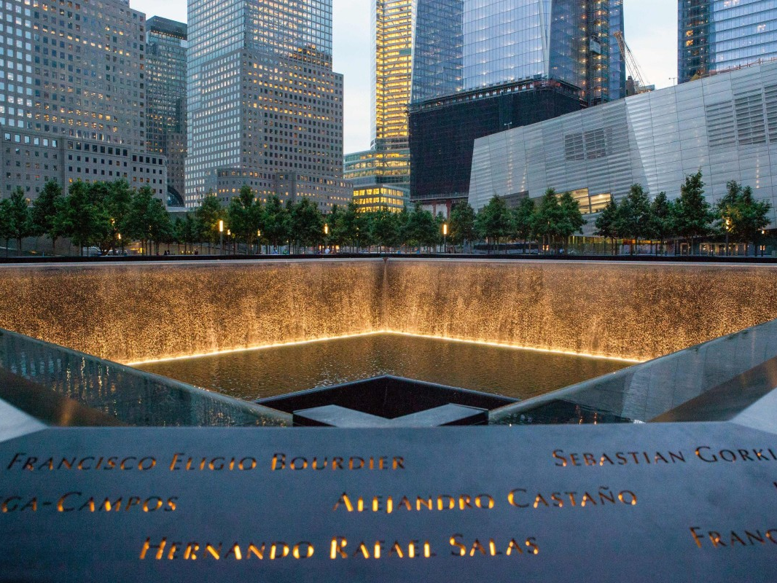

“We erect monuments so that we shall always remember, and build memorials so that we shall never forget.” - Danto
Notes:
Arthur Danto is famous for saying “We erect monuments so that we shall always remember, and build memorials so that we shall never forget.” Memorials are designed to evoke a shared mournful experience. Both monuments and memorials signify a sort of group commitment. While there are personal memorials (I might have a shelf in my house where I place photos of all of my loved ones who have died), the memorials I want to discuss here are public memorials. Memorial sites – places where people perished – are especially poignant. Korsmeyer states, “There is no such things as a traveling exhibit of a memorial site; regardless of what is built or what grows upon it, the real site is not portable and admits no change in location.” Sites are important because, among other reasons, they help us feel causally connected to the lives lost there. We care about the real site because it puts us in touch with the past - when we touch ‘the real thing’ we are part of a temporal causal chain that includes those who created the object, or those who lived or perished on the site. Korsmeyer, in her new book Things: In Touch With The Past, calls this “The Transitivity of Touch.” Sites and authentic relics have this transitivity.
When designing the World Trade Center memorial, the committee took care to honor both the private and public sense of a memorial stating:
Let us begin by acknowledging that memory belongs primarily to the individual: the unique and personal remembrance of someone deeply loved, of shared lives, of unspeakable grief and longing. At the same time, we must acknowledge the extent to which the evolving process of memory also belongs to families and neighborhoods, communities and cities, even entire nations. How to collect the disparate memories of individuals and communities together in one space, with all their various textures and meanings, and give them material, spatial form has always been the daunting challenge of any memorial site.
Public memorials allow for both private and public grief. While their aesthetic qualities may further this goal, their primary goal is not aesthetic. For example, Riegl states, “Memorials designed to impress the viewer often dominate their environs.” Dominating the environs – while perhaps an aesthetic quality – is in service of documenting the enormity of the loss. This seems true of the 9/11 memorial. How do you dominate your environs when your environs are lower Manhattan, situated among large skyscrapers? By making large pools that focus your gaze down instead of up.
The sense of time is different in memorials from monuments. As discussed earlier, monuments want us to remember some value or act – bringing it into the present with us. Memorials are more retrospective. According to Lowenthal, “The memorial act itself implies termination…. Being commemorated alive makes us queasy.” From “Interpretation of Sites of Memory” (a study commissioned by the World Heritage Center of UNESCO, January 31, 2019), “Generally, it is good for a lapse of time to have occurred between the event which is being memorialized and its formal recognition as a heritage place. This is often necessary to allow a proportionate understanding among stakeholders of the nature, character and significance of an event.” UNESCO uses the term “sites of memory” to include sites that either are primarily memorial in nature (such as Auschwitz and Hiroshima) and sites of memory which have a memorial dimension which accompanies other significant heritage values.

Slide 25
Outline of talk
I/ Introduction
II/ Examples:
  Mỹ Sơn Archaeological Sanctuary (A1 kalan)
  9/11 Memorial
  III/ Monuments, Memorials and Ruins
  IV/General Conclusions
Notes:
Destroyed or partially destroyed architectural heritage can also be considered ruins. Once a building becomes a ruin, its function changes. A building’s function is to house people (for work, for living, etc.), a ruin’s “function,” I believe, is to afford us compelling and instructive aesthetic experiences.
While memorials try to keep a particular moment in time in our minds, ruins evoke ephemerality. Elsewhere I have referred to this as the tripartite nature of ruins – the fact that ruins ask us to reimagine the past, engage with what’s on the ground in the present, and project ourselves into the future. In this aspect, ruins stand apart from monuments and memorials. Ruins have a contemplative and aesthetic function distinct from memorials and monuments. Monuments and memorials ask us to remember the past, ruins ask more of us: to imagine those who came before, to engage in the present, and to project into the future. They are memento mori, ephemerality writ large.
There have been past attempts at defining ruins (including my own). I will not attempt a definition here but I will point to a few features I believe are important.

Slide 26
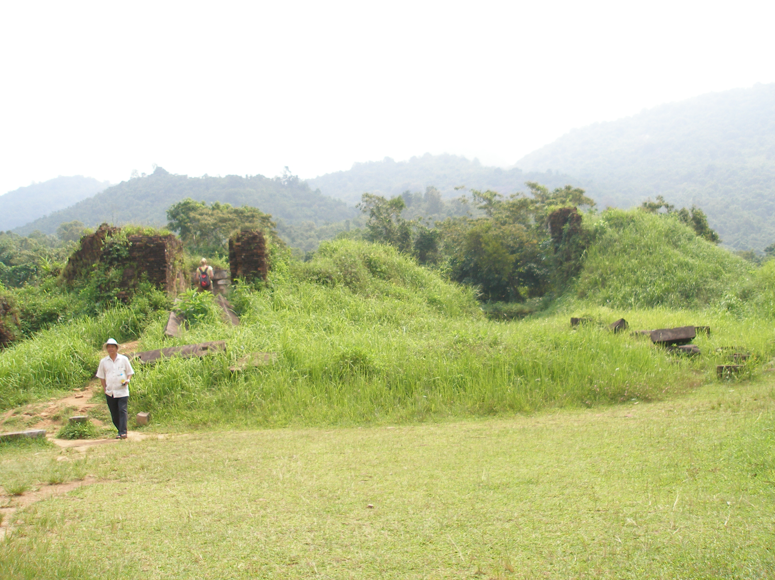

1. Ruins are aesthetically unintended
2. Historic Properties
3. Age value
4. Use value
5. In the process of decay
Notes:
Ruins are aesthetically unintended. This property distinguishes ruins from other types of artifacts (including most monuments and memorials), and puts them in particular contrast to follies (i.e., ‘fake ruins’). Thus, if a folly is aesthetically compelling it is so in a sense that is derivative of the aesthetic value of real ruins.
Those structures that we choose to value as ruins are often valued in part due to their historic properties. When we choose to view an object through the ruin-lens, we often include historic properties with the ruin-frame. Ruins often reflect a history abounding with cultural associations and historical relations.
In a ruin, age-value is esteemed. <I can talk more about age value in q&a but don’t have time for a full discussion here>
Ruins show a change in use-value. Ruins are often seen as devoid of value and consequently devoid of use. A building that can no longer serve its primary function becomes a blight to many communities. Instead of being dysfunctional, I argue, the building’s function has just changed.
Ruins are distinct from reconstructed or repurposed buildings. We do not see them as structures waiting for reassembly. This speaks to their use-value, for in a ruin we see part of its use-value in the beauty of decay.
I believe the most salient feature of ruins, and thus of ruin appreciation, is that ruins are in the process of decay. We do not see an object waiting for reassembly, nor as unfit version of their original structure. Rather we engage with them as object of historical and aesthetic importance. When we conceive of something as a ruin, we see it as in the process of decay. Therefore, if we want to protect or “conserve” the special value of ruins, we must allow them to decay.
The inventory of relevant ruin features I have presented gives some indication as to why a community might want to allow something to be ‘a ruin’ instead of repairing it or erecting a monument or memorial on site. I’ve been arguing that memorials primary function is to evoke a shared mournful experience. Their aesthetic qualities are in service of this primary function. Ruins, as objects in the process of decay, are objects in transition. They do not serve as memorials (or not as well) because they are not static. If ruins are in the process of decay, every time we visit them we will encounter different aesthetic properties. This transience is particularly good at evoking the sort of ruminations I have described (ephemerality, memento mori), but transience is not what most memorials are after.

Slide 27
Some brief application
Notes:
While both sites contain some original materials (e.g., the pedestal in A1 and the “last column” “Impact steel” and “tridents” at the WTC), there are important differences. In the case of Mỹ Sơn, we have both the original site and materials. WTC we have the original site and materials preserved. The memorial does not preserve the objects, such as the trident, as ruins but rather as a fragment of a once grander whole. These fragments are not left to ruinate in the memorial, but rather are treated like relics. Importantly these fragments are not ruins in part because they are not in the process of decay but also because they have been dislocated from their original location. (They are not in situ.) We could remove the pedestal remains of A1 and put it into a museum, but then we would transform the object from ruin – an object in the process of decay and wedded to its environment –into something else. Allen Carlson warns us against such a transgression when it comes to the aesthetic appreciation of nature. When we remove driftwood from the shores of the beach and place it on our mantle, we remove an object from its natural environment and treat it like a “readymade.”
So the memorial and ruin share an interest in age value, the transitivity of touch, and in the importance of place. They differ in their use of the physical remains. Monuments, while they might contain some fragments or relics, are not primarily valued for these remains. In a memorial the remains service another goal– to mourn. In order to mourn the fallen, we keep the fragments static – we preserve them in a particular time slice – as found.
When a community is facing the decision as to what to do with the physical remains of war, I’d like to suggest they think of the use value of what remains. Economic concerns will no doubt reign supreme, but I hope communities will think of the stone’s and site’s use value. Do they feel the need to memorialize the dead? Or would they like an evocative space to ponder our mortality? Perhaps what was destroyed was so valued in the culture that there is a need to reconstruct it – a church or a meeting hall.
It also makes sense that A1 was kept a ruin in contrast to the WTC for another reason. A1, built almost a thousand years ago was ruinated in the 1970s. It took about thirty years for the site to receive the attention it deserved. A significant amount of time had passed from the point when it was used as a religious site to the point it was used as a military outpost. After the war, there was no immediate use value for the site. As such, there was little need to rebuild and it lay dormant. In contrast, the WTC was a vibrant place of business at the time of its destruction and the local communities and families of those affected by the bombing did not feel like they could wait 30 years for a solution for the space. Keeping some of ground zero a ruin was not a sensible option. New ruins – ruins of contemporary civilizations – are often too overwhelming to elicit the sort of ruin gazing I have been discussing.

Slide 28
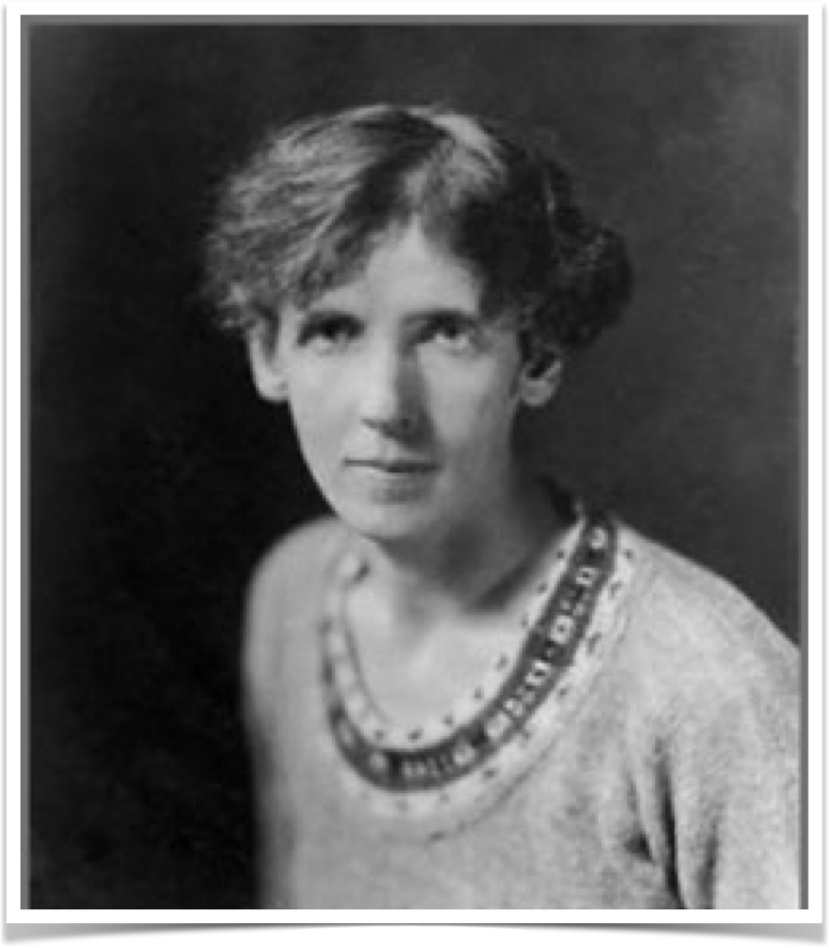
“New ruins have not yet acquired the weathered patina of age, the true rust of the barons’ wars, not yet put on their ivy, nor equipped themselves with the appropriate bestiary of lizards, bats, screech-owls, serpents, speckled toads and little foxes which, as has been so frequently observed by ruin-explorers, hold high revel in the precincts of old ruins…But new ruins are for a time stark and bare, vegetationless and creatureless; blackened and torn, they smell of fire and mortality.”
Notes:
Here Dame Rose Macaulay, the author of The Pleasure of Ruins: “New ruins have not yet acquired the weathered patina of age, the true rust of the barons’ wars, not yet put on their ivy, nor equipped themselves with the appropriate bestiary of lizards, bats, screech-owls, serpents, speckled toads and little foxes which, as has been so frequently observed by ruin-explorers, hold high revel in the precincts of old ruins…But new ruins are for a time stark and bare, vegetationless and creatureless; blackened and torn, they smell of fire and mortality.” (Macaulay, 453). The WTC site was too raw to allow to ruinate.

Slide 29
What’s the use?
Reconstructing cultural property after war
Dr. Elizabeth Scarbrough
Florida International University
Notes:
In this brief presentation I have detailed two cases where communities appropriately WEIGHED the use value of a site. The A1 Kalan at the Mỹ Sơn Archaeological Complex was deemed a ruin and allowed to ruinate, while the rubble from the World Trade Center 9/11 attacks was cleared and a memorial site was erected. I detailed some of the differences between monuments, memorials, and ruins according to their use value, with a particular focus on memorials and ruins. Ruins have a primary aesthetic function, allowing for ruin gazing. Whereas the aesthetic considerations of memorials are in service of the primary function – to mourn. When communities are faced with the debris of war they should consider what the use value of the debris should be going forward. This will guide them in the decision to preserve, conserve, or allow materials to ruinate.

Slide 30
Images
Trident: https://www.interiordesign.net/projects/10093-experiencing-memory-designers-reflect-on-the-911-m/
Angel of 9/11: https://www.nbcnews.com/sciencemain/angel-9-11-steel-visage-tricks-eye-touches-heart-2D11674288
9/11 museum arial shot & impact steel : https://inhabitat.com/nyc/911-memorial-museums-design-honors-the-history-and-recovery-of-ground-zero/911-museum-rendering-aerial-snohetta
WTC before the bombing: https://www.thoughtco.com/the-twin-towers-178538
Footprint picture: https://www.nycgo.com/museums-galleries/9-11-memorial-museum
Beacon of light: Public Domain: World Trade Center Memorial by Denise Gould (DOD Photo 060911-F-9471G-006)
WTC names at night: http://chqdaily.com/2018/08/allison-blais-multimedia-presentation-to-focus-on-9-11-memorial-museum/
Trident standing from Young article

