Slide 1
Comments
“Aestheticizing Rape”
Elizabeth Scarbrough
Florida International University
escarbro@fiu.edu
F
Florida International University

Slide 2
“The aesthetics of rape is a broad category that includes aesthetic attitudes, tastes, aesthetic values, and aestheticizing representations that take rape as their object.”

Slide 3
  Tarquin’s red attire
  Lucretia’s sexualized, titillating pose
  The eroticization of Lucretia’s flesh
  Lucretia’s resemblance to Venus

Slide 5

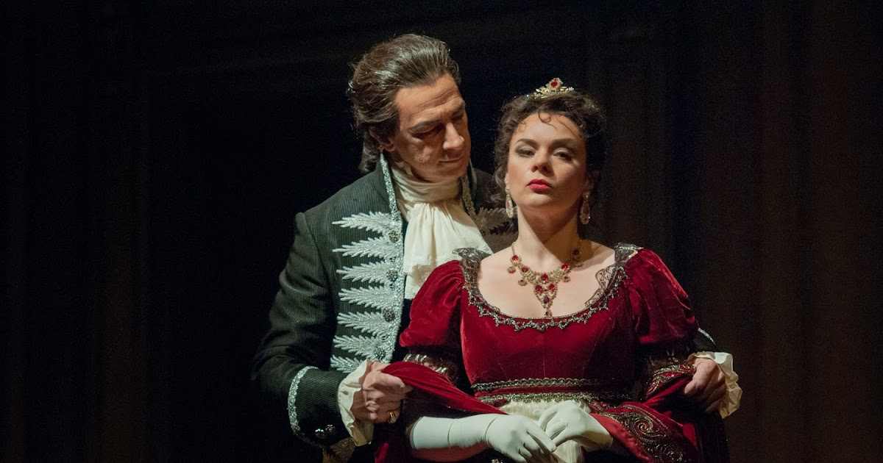
Two examples from opera
Tosca

Slide 6
“I think a big problem with violence against women in opera is the empathy with the male perpetrators.”
Michelle Rofrano, PROTESTRA
Tosca

Slide 7
“I think a big problem with violence against women in opera is the empathy with the male perpetrators.”
Michelle Rofrano, PROTESTRA
Tosca
Kate Manne, himpathy

Slide 8

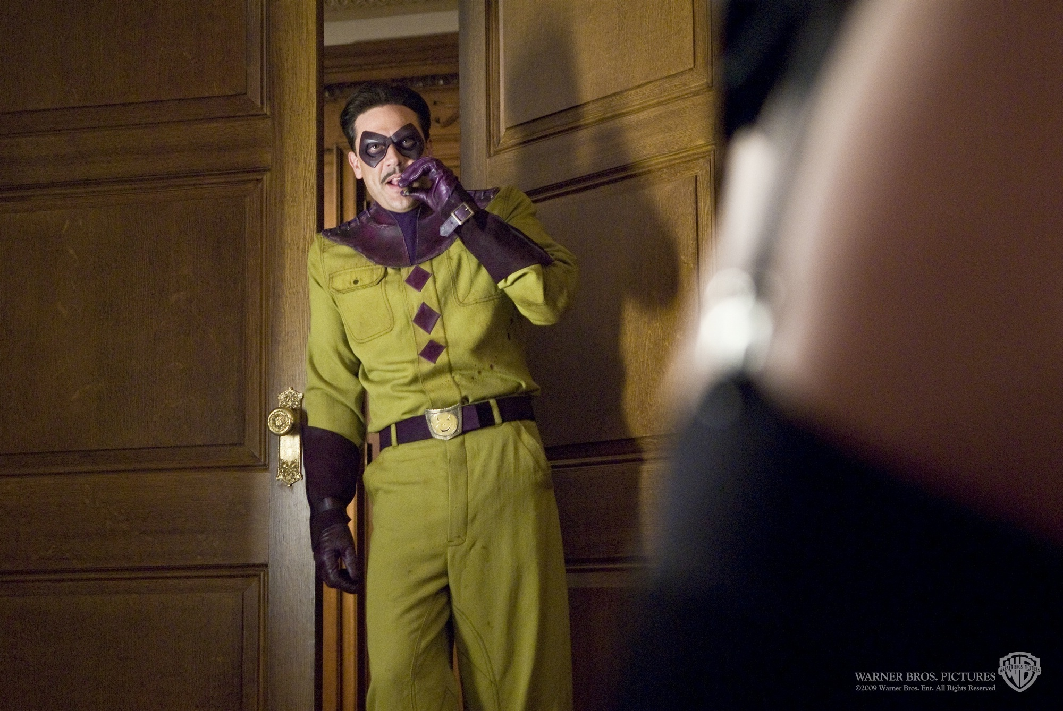

Slide 9
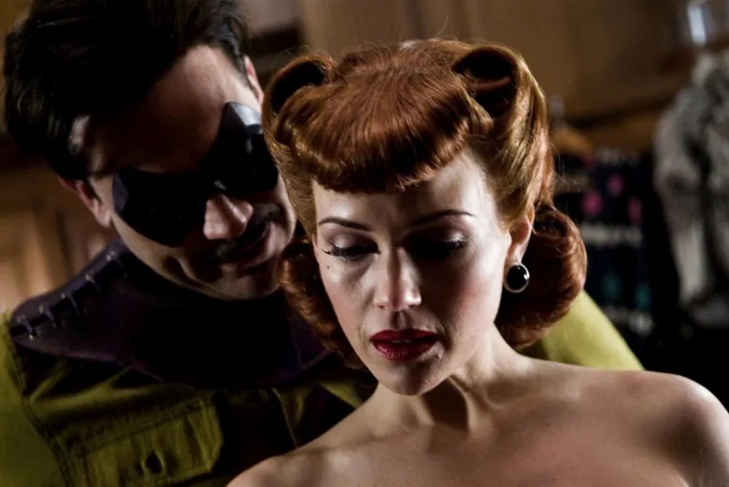

Slide 10

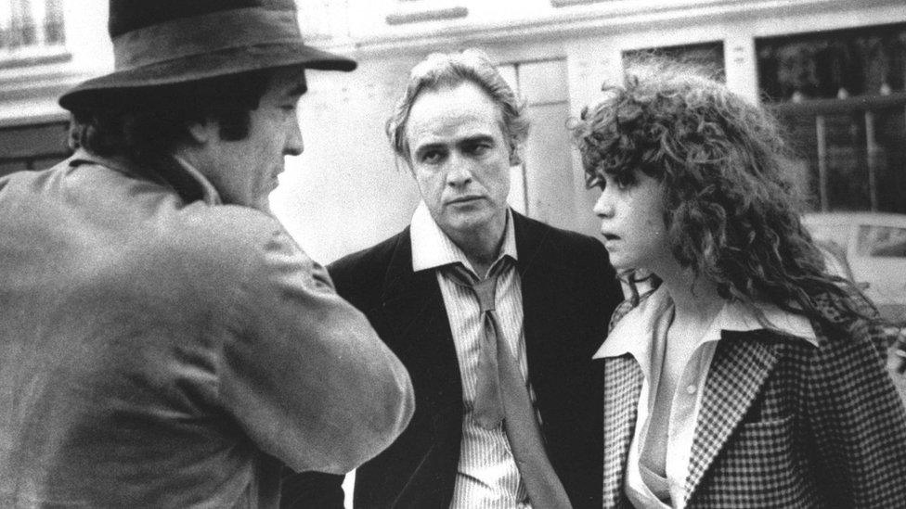
Bernardo Bertolucci , Marlon Brando and Maria Schneider

Slide 12

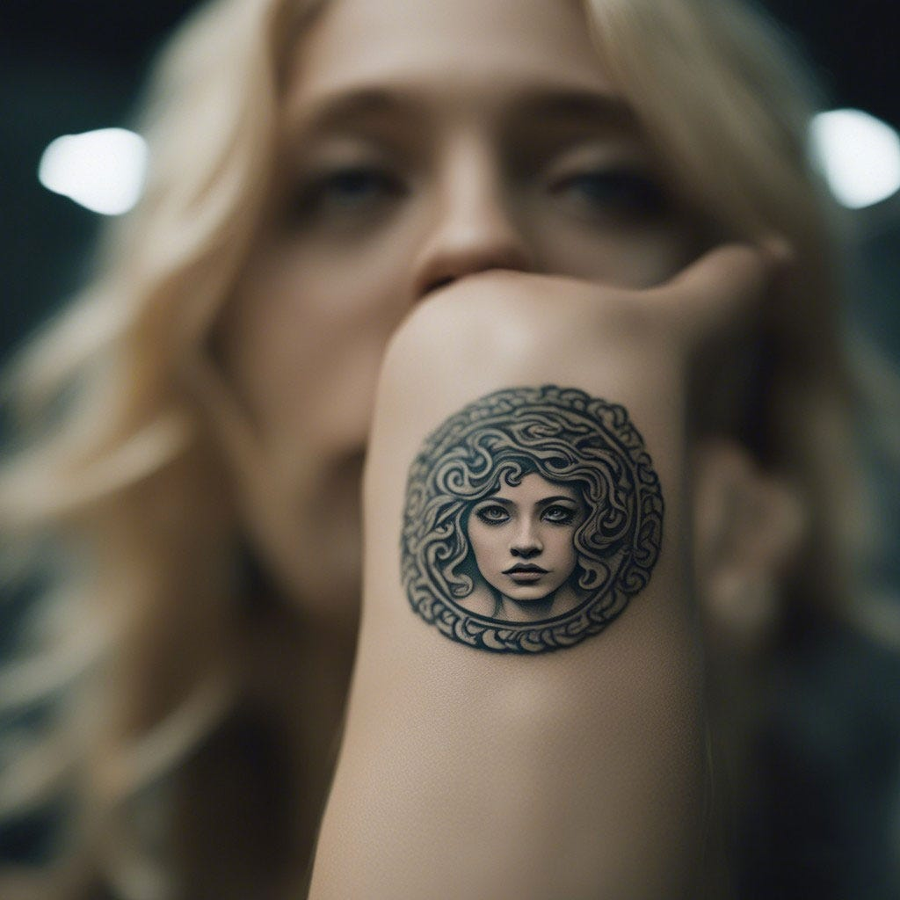
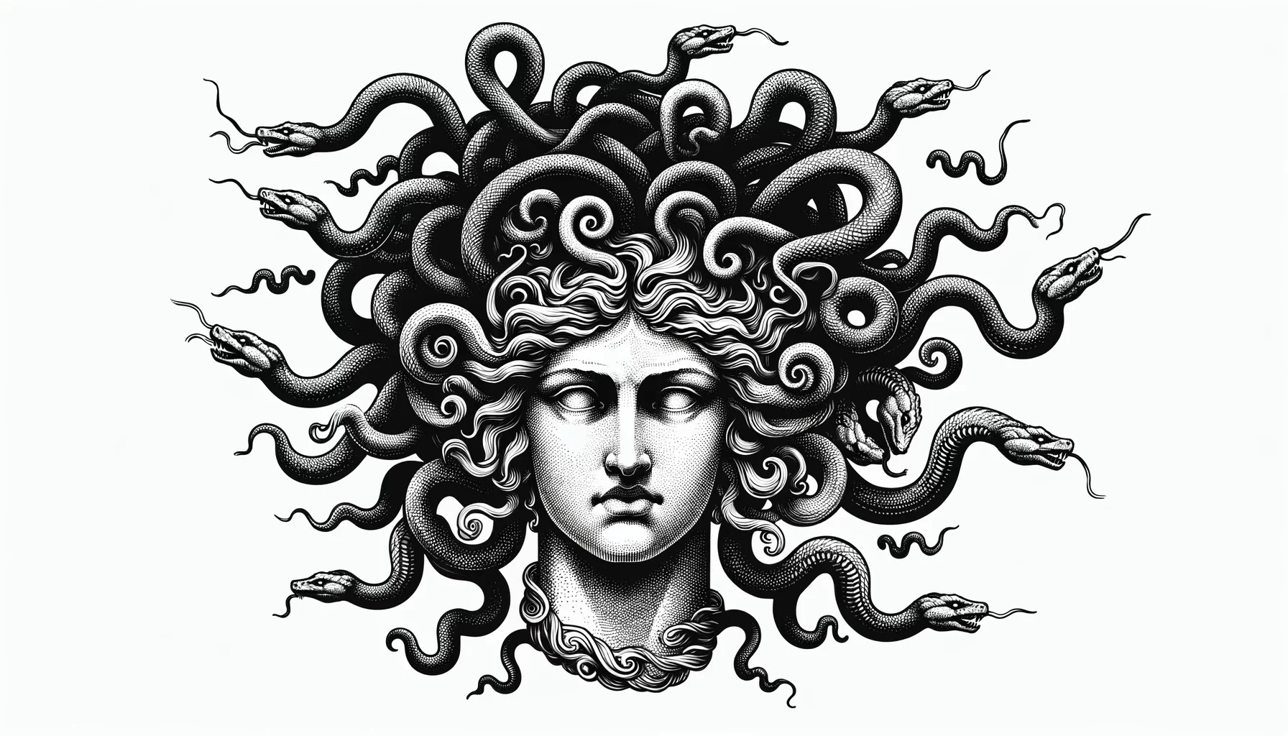

Slide 13


Slide 14
Thanks!
Elizabeth Scarbrough
escarbro@fiu.edu

